Slide 1
The Wage Debate
HOW DO WE REDUCE POVERTY AMONG LOW-INCOME WORKERS?
By Chirag Biswas

Slide 3
Origins
Great Depression
Fair Labor Standards Act of 1938
Signed by FDR
Established Wage (Romich, 22-25.)

Slide 4
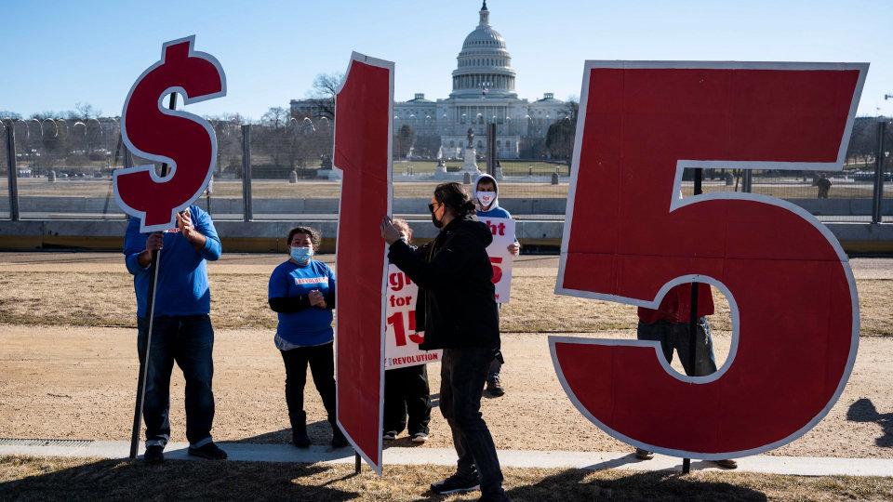
Today
Fair Minimum Wage Act, 2007
Raises wage to $7.25, 2009
Movement for $15 per hour wage
Other unsuccessful pushes
(Romich, 22-25.)
(Wall Street Journal)

Slide 5
How effective would a higher minimum wage in the United States be at helping families and communities with a lower socioeconomic status, compared to alternative routes to raise living conditions?

Slide 6
First,a Solution
- A minimum wage would be beneficial, if it were a moderate increase
- Must also be accompanied with other measures
- Tax credit expansion and tax decreases will help

Slide 7
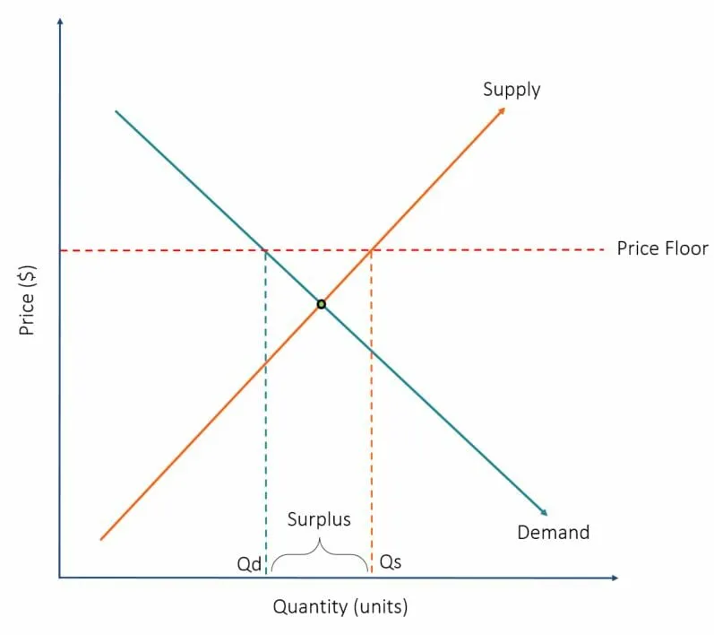
Effects on Unemployment..
- MINIMUM WAGE IS A PRICE FLOOR
- LEADS TO A SURPLUS
(Corporate Finance Institute)

Slide 8
...And Price Level
- As wages go up, prices go up
- Passed down to the consumer
- Causes prices to go up
- However, recent data does not suggest this (Dube, 538-539.)
- Likewise, unemployment is shown to have affected little from recent data (Card & Krueger, 826-828.)

Slide 9
Effects on Specific Industries
- Restaurant Industry
- Wage increase might negatively affect workers based off "pooling"
- Little effect on unemployment (Even, 22-23.)
(Seattle Metropolitan)

Slide 10
Effects on Specific Industries
- Restaurant Industry
- Wage increase might negatively affect workers based off "pooling"
- Little effect on unemployment (Even, 22-23.)
(Seattle Metropolitan)

Slide 11
Alternative Strategies
EITC for low-income families
SNAP for nutrition
Expansions of these programs
Tax Decreases
Could stimulate the economy
(Romich, 18-22.)

Slide 12
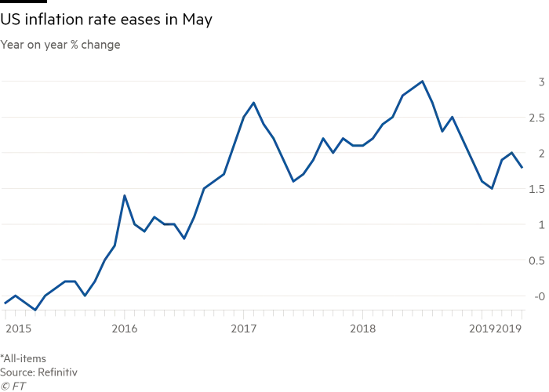
Inflation
- Rate of value change of currency
- Wages eventually fall due to inflation
- Helps by indexing wages to inflation rate
(Financial Times)

Slide 13
To Conclude

Slide 14
Bibliography
Aaronson, Daniel, et al. “The Minimum Wage, Restaurant Prices, and Labor Market Structure.” The Journal of Human Resources, vol. 43, no. 3, 2008, pp. 688–720. JSTOR, www.jstor.org/stable/40057364. Accessed 14 Apr. 2021.
Addison, John T. “The Effects of Minimum Wages on Employment: The Legacy of Myth and Measurement.” ILR Review, vol. 70, no. 3, 2017, pp. 814–818. JSTOR, www.jstor.org/stable/26944728. Accessed 20 Apr. 2021.
Bamberger, Bill. Hoops. The National Building Museum,2016, https://www.nbm.org/exhibition/hoops/
Brown, Charles C., and Daniel S. Hamermesh. “Wages and Hours Laws: What Do We Know? What Can Be Done?” RSF: The Russell Sage Foundation Journal of the Social Sciences, vol. 5, no. 5, 2019, pp. 68–87. JSTOR, www.jstor.org/stable/10.7758/rsf.2019.5.5.04. Accessed 16 Apr. 2021.

Slide 15
Bibliography cont.
CAMPOLIETI, MICHELE. “Effects of Minimum Wages on Employment Dynamics and Prices in the Restaurant Sector: Canada, 1983–2016.” Canadian Public Policy / Analyse De Politiques, vol. 44, no. 4, 2018, pp. 317–341. JSTOR, www.jstor.org/stable/26585556. Accessed 16 Apr. 2021.
Card, David, and Alan B. Krueger. “Myth and Measurement and the Theory and Practice of Labor Economics.” ILR Review, vol. 70, no. 3, 2017, pp. 826–831. JSTOR, www.jstor.org/stable/26944731. Accessed 14 Apr. 2021.
Dube, Arindrajit, et al. “The Economic Effects of a Citywide Minimum Wage.” Industrial and Labor Relations Review, vol. 60, no. 4, 2007, pp. 522–543. JSTOR, www.jstor.org/stable/25249108. Accessed 12 Apr. 2021.
Even, William E., and David A. Macpherson. “The Effect of the Tipped Minimum Wage on Employees in the U.S. Restaurant Industry.” Southern Economic Journal, vol. 80, no. 3, 2014, pp. 633–655., www.jstor.org/stable/23809644. Accessed 13 Apr. 2021.
Hill, Heather D., and Jennifer Romich. “How Will Higher Minimum Wages Affect Family Life and Children’s Well‐Being?” Child Development Perspectives, vol. 12, no. 2, June 2018, pp. 109–114. EBSCOhost, doi:10.1111/cdep.12270.
KAUFMAN, BRUCE E. “INSTITUTIONAL ECONOMICS AND THE MINIMUM WAGE: BROADENING THE THEORETICAL AND POLICY DEBATE.” Industrial and Labor Relations Review, vol. 63, no. 3, 2010, pp. 427–453. JSTOR, www.jstor.org/stable/40649711. Accessed 24 Mar. 2021.

Slide 16
Bibliography Cont.
Lee, Dwight R. “The Two Moralities of the Minimum Wage.” The Independent Review, vol. 19, no. 1, 2014, pp. 37–46. JSTOR, www.jstor.org/stable/24563257. Accessed 25 Mar. 2021.
LOPRESTI, JOHN W., and KEVIN J MUMFORD. “WHO BENEFITS FROM A MINIMUM WAGE INCREASE?” ILR Review, vol. 69, no. 5, 2016, pp. 1171–1190. JSTOR, www.jstor.org/stable/26753694. Accessed 24 Mar. 2021.
Luce, Stephanie. “$15 Per Hour or Bust: An Appraisal of the Higher Wages Movement.” New Labor Forum, vol. 24, no. 2, 2015, pp. 72–79., www.jstor.org/stable/24718599. Accessed 12 Apr. 2021.
MaCurdy, Thomas. “How Effective Is the Minimum Wage at Supporting the Poor?” Journal of Political Economy, vol. 123, no. 2, 2015, pp. 497–545. JSTOR, www.jstor.org/stable/10.1086/679626. Accessed 12 Apr. 2021.
Mishel, Lawrence, et al. “Wage Inequality: A Story of Policy Choices.” New Labor Forum, vol. 23, no. 3, 2014, pp. 26–31., www.jstor.org/stable/24718538. Accessed 20 Apr. 2021.
Rankine, Claudia. The Meaning of Serena Williams. The New York Times Magazine, August 25, 2015. https://www.nytimes.com/2015/08/30/magazine/the-meaning-of-serena-williams.html

Slide 17
Bibliography cont.
Jennifer Romich, and Heather D. Hill. “Coupling a Federal Minimum Wage Hike with Public Investments to Make Work Pay and Reduce Poverty.” RSF: The Russell Sage Foundation Journal of the Social Sciences, vol. 4, no. 3, 2018, pp. 22–43. JSTOR, www.jstor.org/stable/10.7758/rsf.2018.4.3.02. Accessed 14 Apr. 2021.
SABIA, JOSEPH J., et al. “WHEN GOOD MEASUREMENT GOES WRONG: NEW EVIDENCE THAT NEW YORK STATE'S MINIMUM WAGE REDUCED EMPLOYMENT.” ILR Review, vol. 69, no. 2, 2016, pp. 312–319., www.jstor.org/stable/24810361. Accessed 25 Mar. 2021.
Tsao, Tsu-Yu, et al. “Estimating Potential Reductions in Premature Mortality in New York City From Raising the Minimum Wage to $15.” American Journal of Public Health, vol. 106, no. 6, June 2016, pp. 1036–1041. EBSCOhost, doi:10.2105/AJPH.2016.303188.
Wilmers, Nathan. “Wage Stagnation and Buyer Power: How Buyer-Supplier Relations Affect U.S. Workers’ Wages, 1978 to 2014.” American Sociological Review, vol. 83, no. 2, 2018, pp. 213–242. JSTOR, www.jstor.org/stable/48589214. Accessed 15 Apr. 2021.

